Slide 1



Novel Shape Generation with
SO(3)-Equivariant Auto-Encoders
Ethan Chun and Shayan Pardis
Notes:
We can both do title

Slide 2
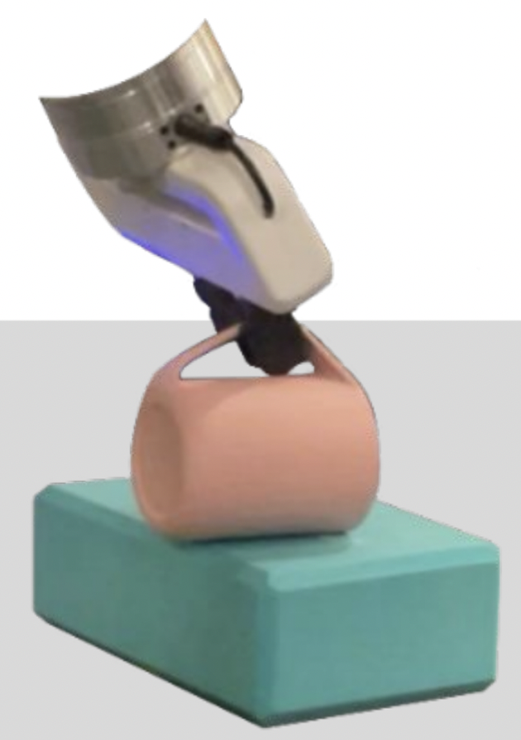
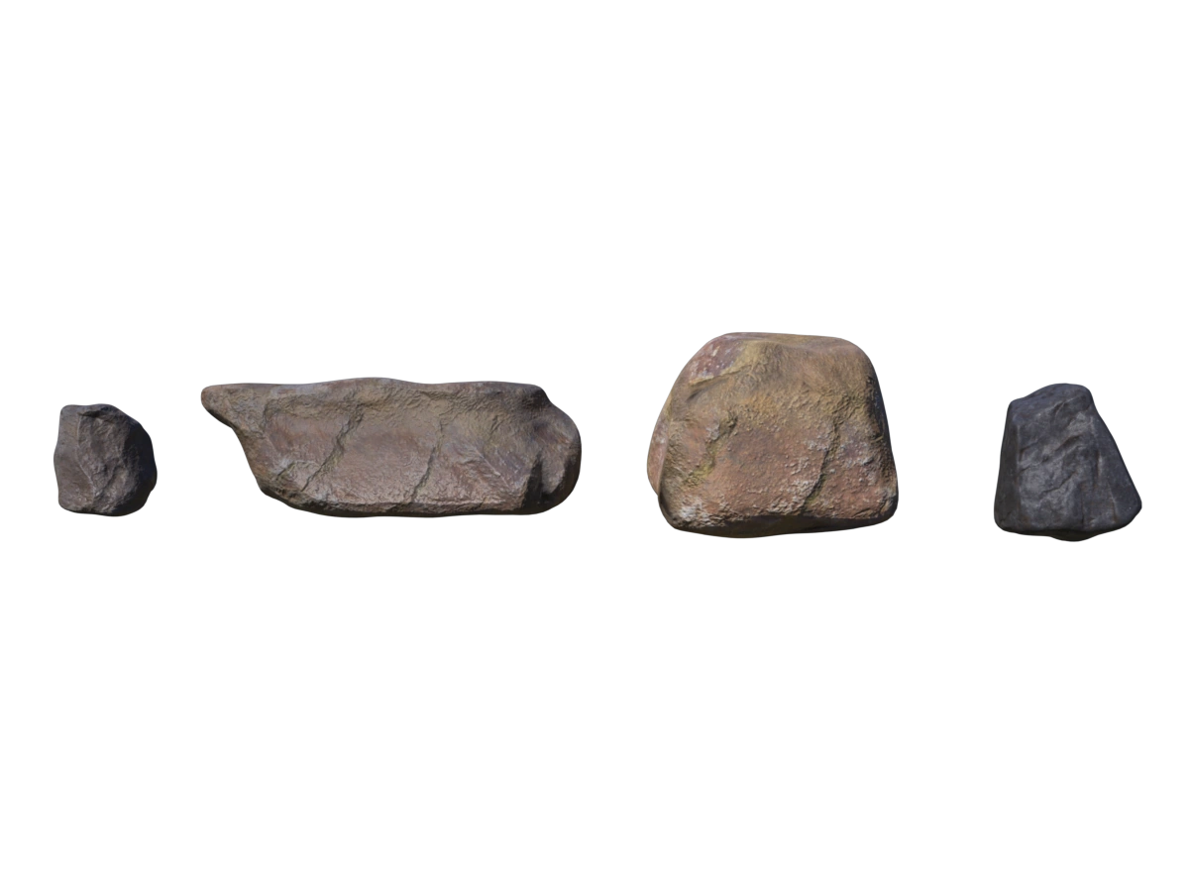
Motivation
https://3dmodelsworld.com/downloads/rock-pack-pbr-3d-model/
https://elchun.github.io/lndf/
Notes:
Ethan
3D Object generation is crucial to stuff
Objects have a canonical pose, not have to do augmentation with all rotations in SO3
Design SO3 equivariant network so that you can feed in a little data regardless of pose, and generate a diverse set of shapes.

Slide 3
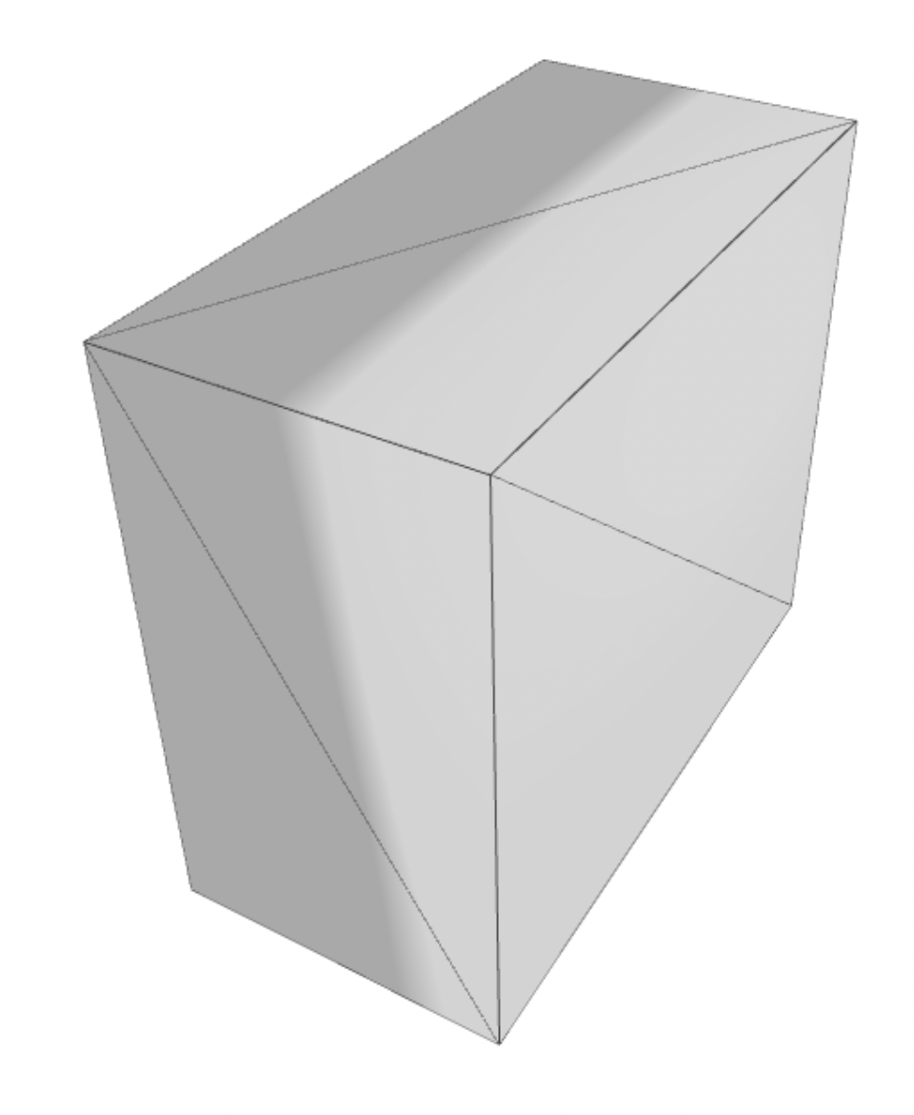
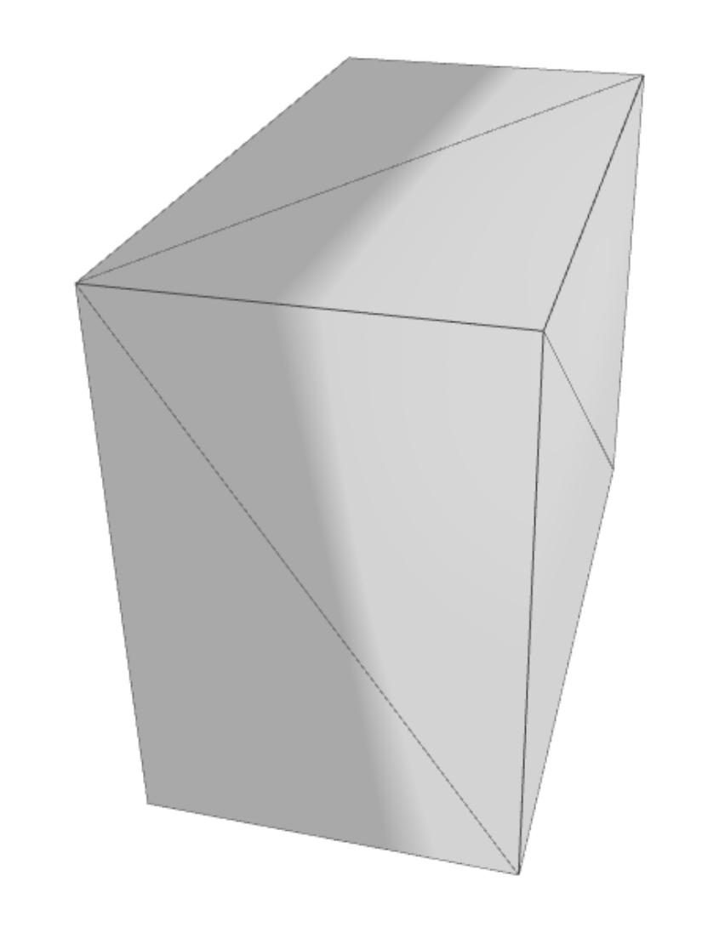
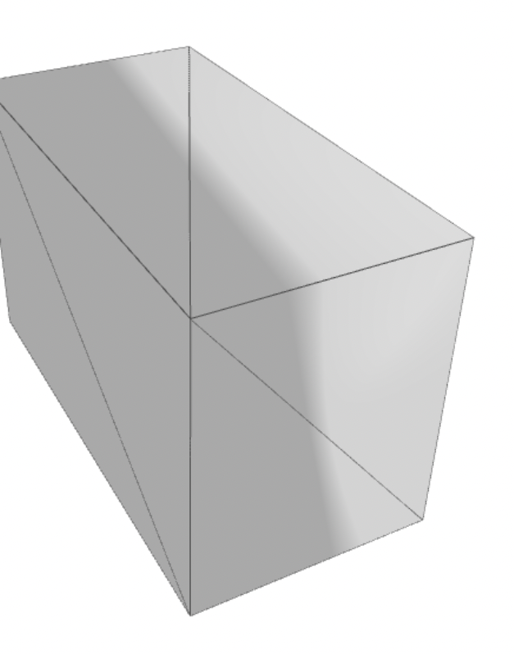
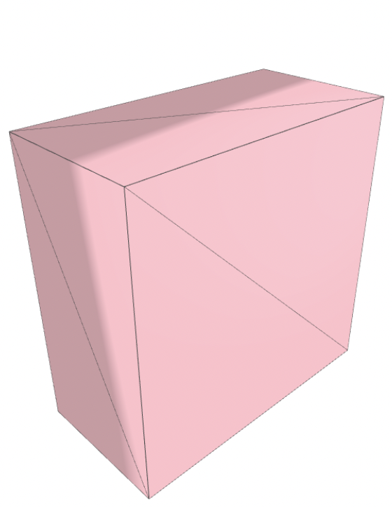
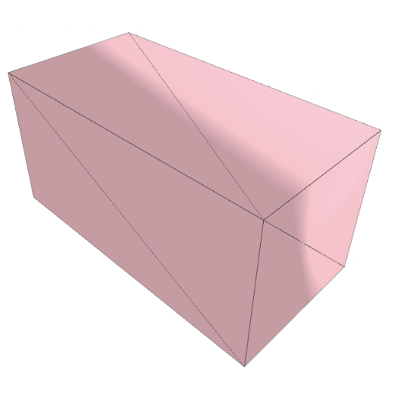
Problem Formulation
Desired Interpolation
Initial State
Final State
Notes:
Ethan
Tricky to generate large models
To test the feasibility of the problem, we restrict our domain to interpolation in an autoencoder

Slide 4
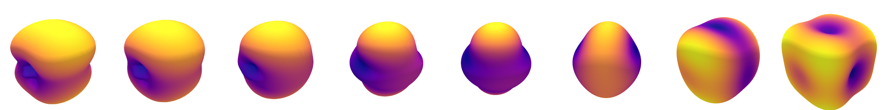

Problem Formulation
Learning a rich latent representation
Equivariant models: only learn the shape
Interpolating between objects
Rotation and changing the shape should be independent
???
Notes:
Shayan
Given a set of boxes, want to generate new boxes

Slide 5
Methodology

Slide 6
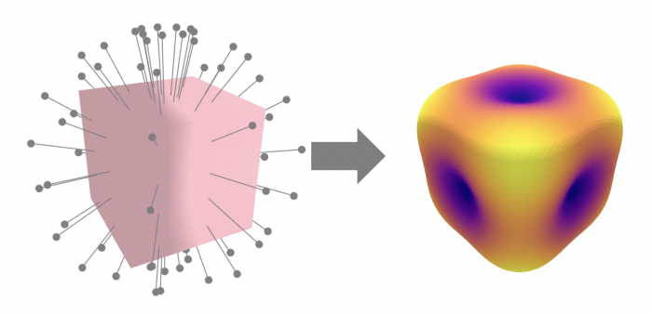
Method: Spherical Harmonics for 3D Shapes
Notes:
Ethan
Some way to represent shapes such that an SO3 equivariant network can perform reconstruction.
Non uniform distribution

Slide 7
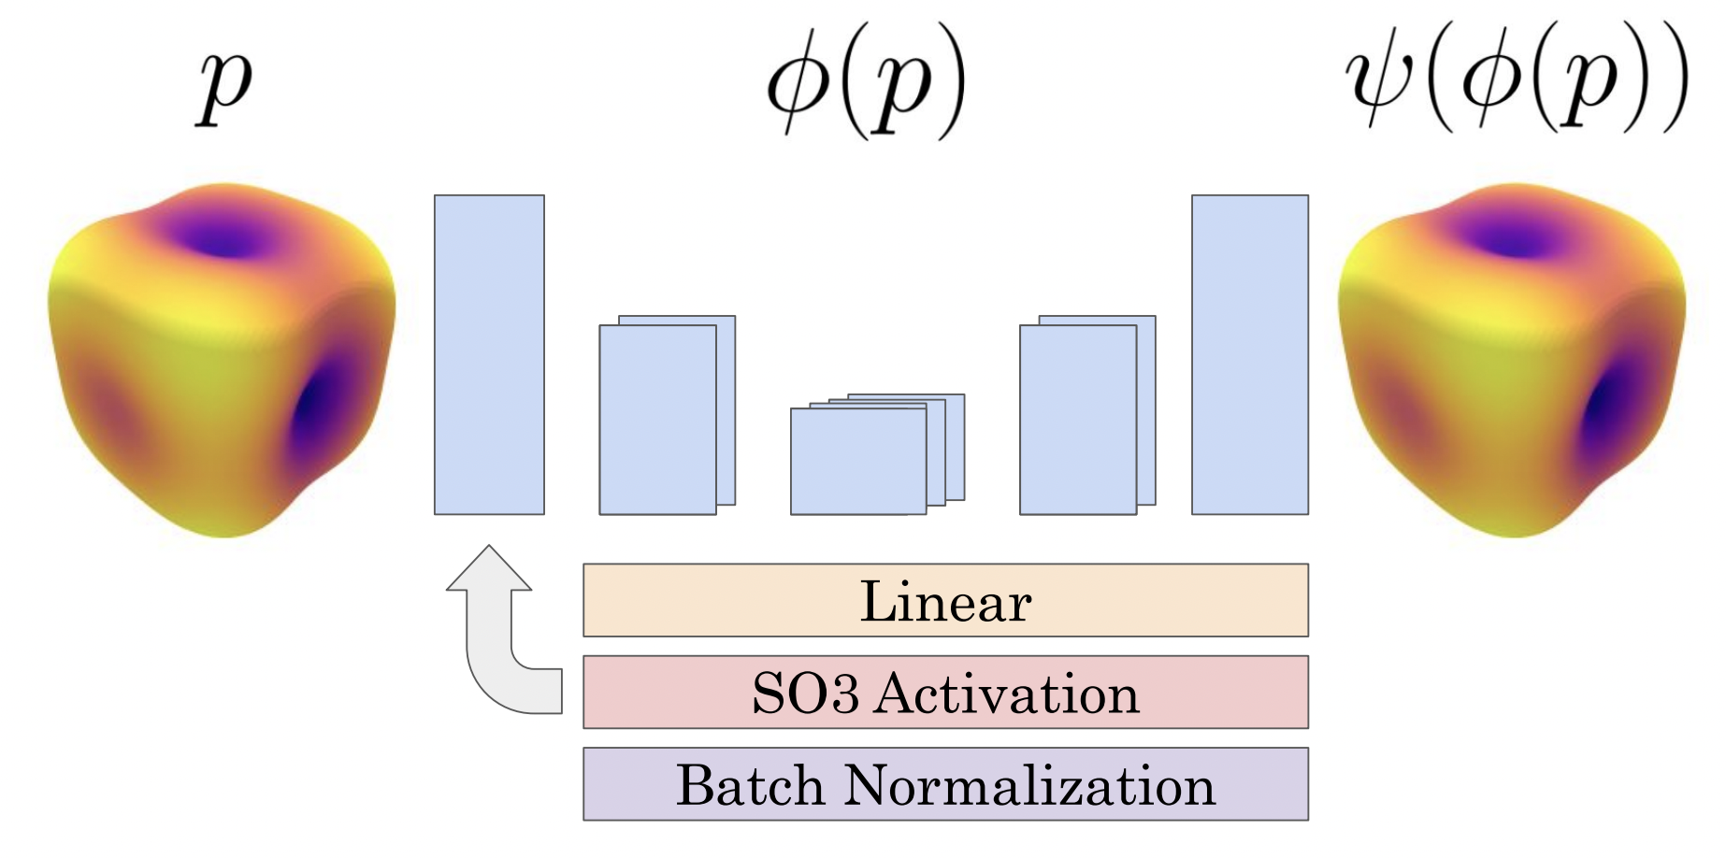
Method: Equivariant Autoencoder
Notes:
Shayan
Based on Spherical CNN
Different size layer, we define lmax to be the degree of the representation
max degree of representation
Start at large, go small

Slide 8
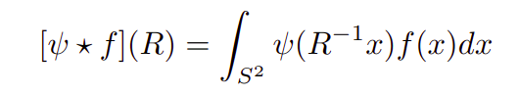
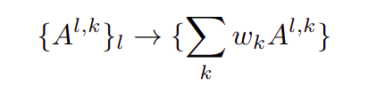
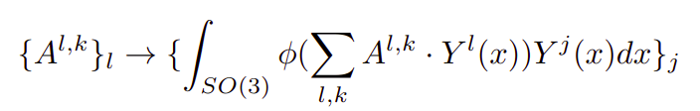
Method: Equivariant Autoencoder
Convolution lives in the SO(3) space
Linear Layer: Increase Channels
SO(3) Activation: Reducing l_{max}
Notes:
Shayan

Slide 9
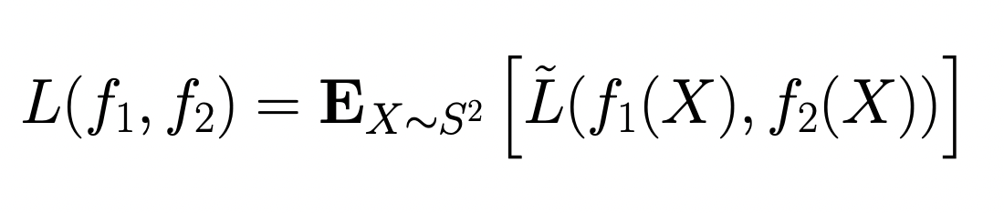
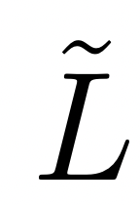
Method: Loss Function
f_{i}(X) in Euclidean Space
= Huber Loss
Notes:
Ethan

Slide 10
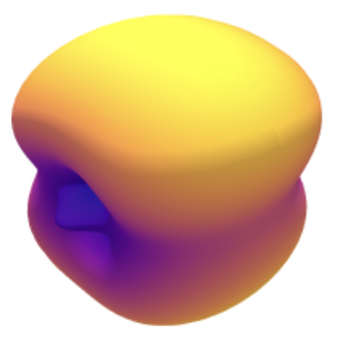
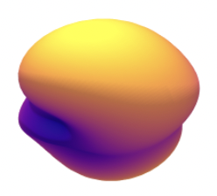
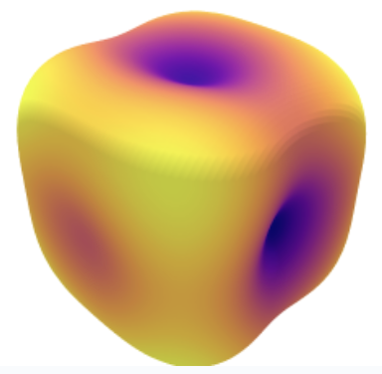
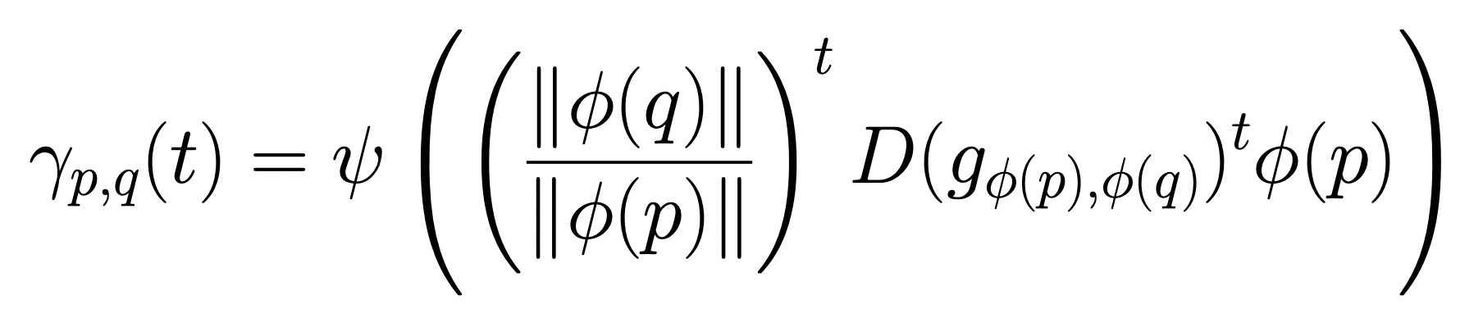
Method: Interpolation
Notes:
Shayan

Slide 11
Results

Slide 12
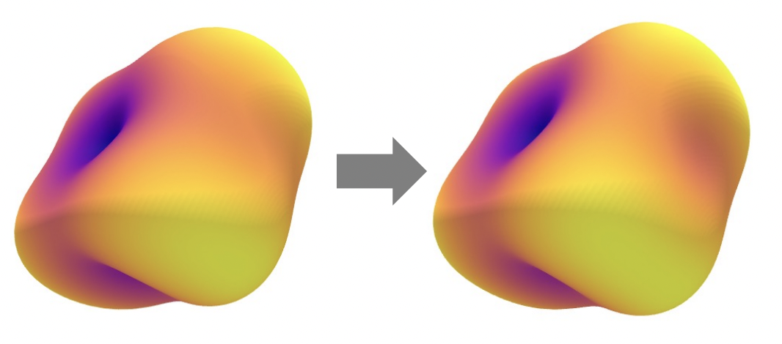
Results: Reconstruction
Notes:
Ethan

Slide 13
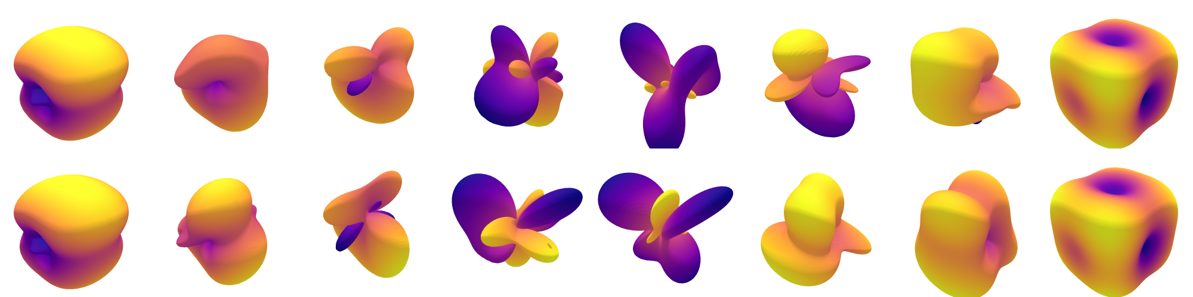
Results: Interpolation (the curse of l > 1)
Linear Interpolation
Equivariant Interpolation
Notes:
Shayan
Todo: Make fully connected mlp with similar number of weights
Make figure to show why it fails?

Slide 14
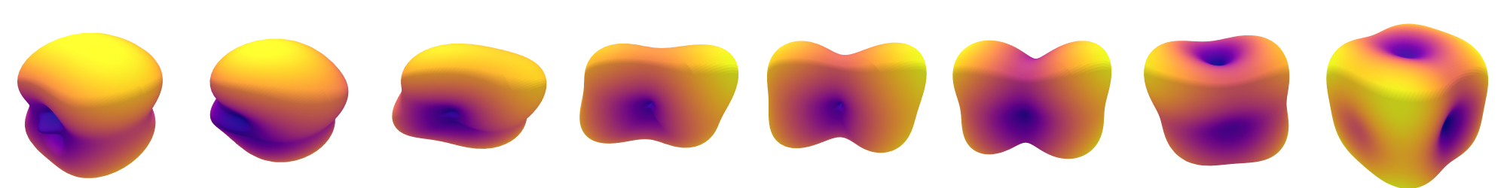
Results: Interpolation (l = 1)
Linear Interpolation
Linear Interpolation
Equivariant Interpolation
Equivariant Interpolation
Notes:
Shayan
Todo: Make fully connected mlp with similar number of weights
Make figure to show why it fails?

Slide 15
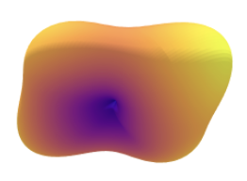
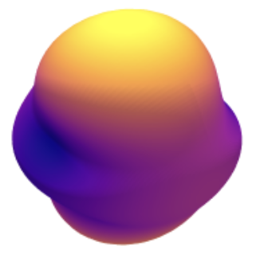

Results: Interpolation (l = 1)
Small Rotation
→ Similar Interpolation
Large Rotation
→ Different Interpolation
In small rotations, linear interpolation is almost the same as equivariant interpolation
Notes:
Shayan\
introduce what figure means,
Move earlier

Slide 16
Open questions and challenges
Optimization Network with l_{max}= 1 is much more challenging
l_{max}= 1 → 5000 epochs
l_{max}= 2 → 200 epochs
Is it possible to define a nice interpolation for l_{max}> 1?
Transformation from shape to spherical harmonics is lossy
Using Tensor-Field to preserve quality?
Notes:
Ethan
problem with opt landscape
We didn’t show the generalization (did we?) (we didn’t use the information bottleneck of auto encoders (did we?)
limit of lmax

Slide 17
Thanks for Watching!
Notes:
Ethan

Slide 18
Results: Interpolation (l = 1)
In small rotations, linear interpolation is almost the same as equivariant interpolation

Slide 19
Limitations and Future work
Using fixed l_max is limiting the quality
Maybe we could use Tensor Field
We didn’t show the generalization (did we?) (we didn’t use the information bottleneck of auto encoders (did we?)

Slide 20
Problem Formulation
Desired Interpolation
Initial State
Final State
Notes:
To test the feasibility of the problem, we restrict our domain to interpolation between rectangular prisms

Slide 21
Problem Formulation
Rotation
+
Interpolation
Initial State
Desired Interpolation
Final State
Notes:
To test the feasibility of the problem, we restrict our domain to interpolation between rectangular prisms
The idea is to separate the rotation and

